Slide 1

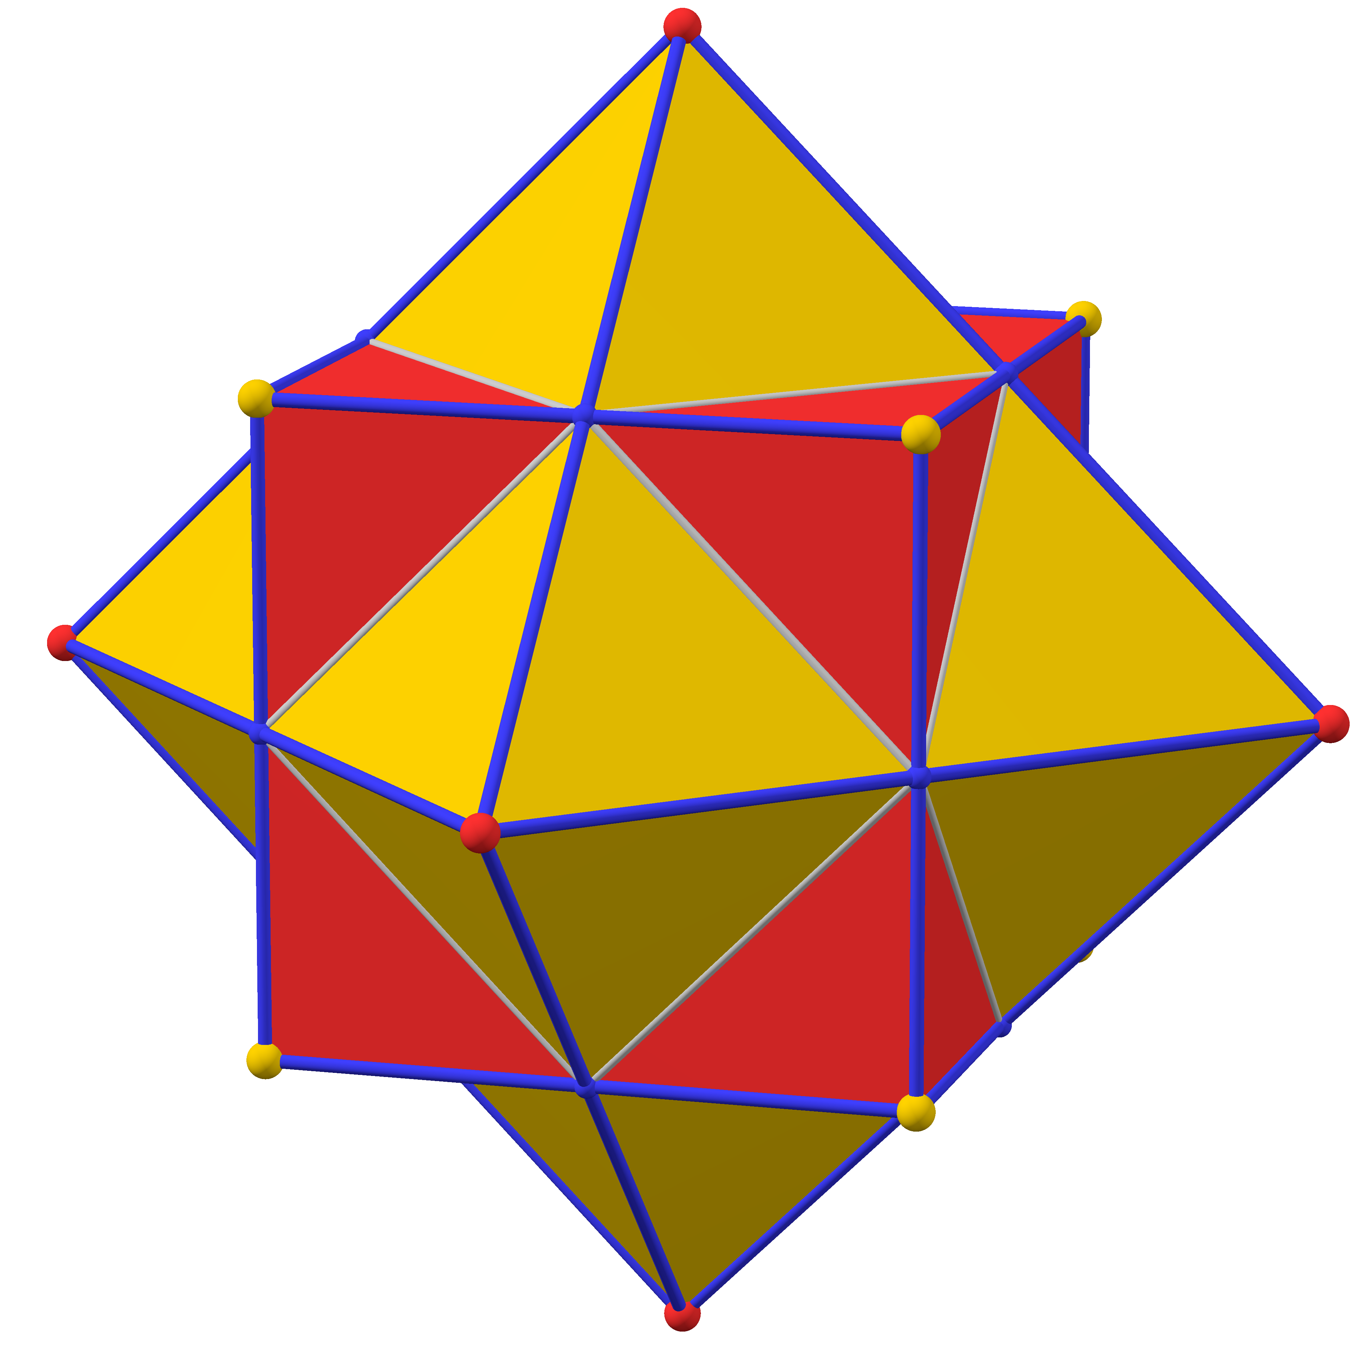
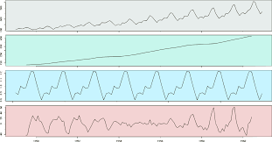
Decision Support Analysis
May 2025

Slide 2
Logistics
Schedule: Monday 17:00 a 19:00 hrs (GMT-6).
Thursday 17:00 a 19:00 hrs (GMT-6). (5:30)
Contact email: jorge.ramos.z@tec.mx
Software: Excel, (Minitab) (R, Python).

Slide 3
About me
I have worked for different companies in different industries: Northware, Farmacias del Ahorro, Johnson Controls, Cemex.
My roles are usually data related: Data Scientist, Data Custodian (Data Governance) and Data Engineer/Data Architect.

Slide 4
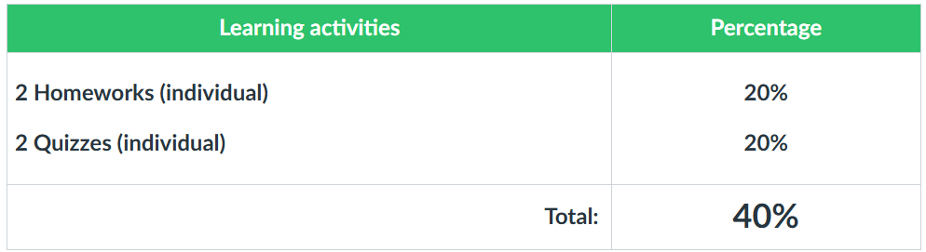
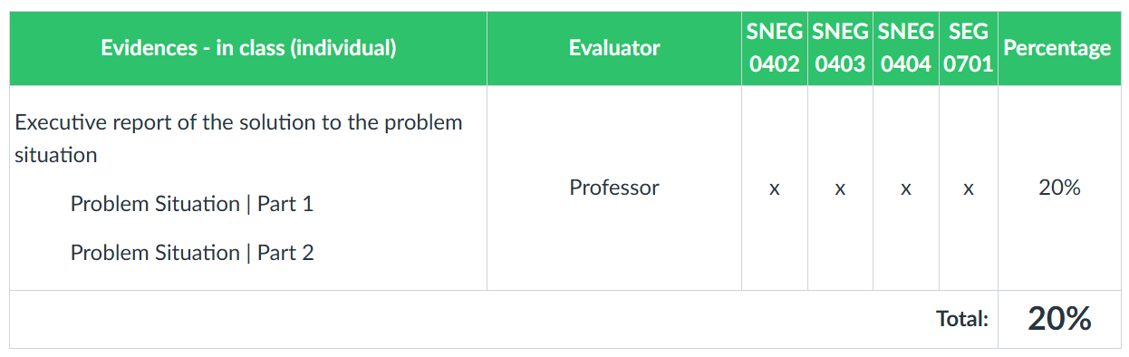
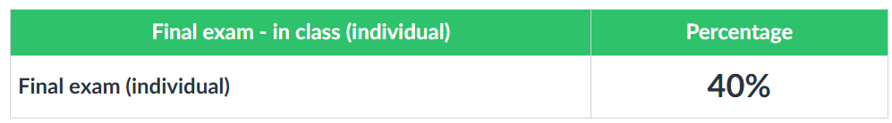
Evaluation Plan

Slide 5
Overview
Linear Programming
Time Series
Linear Regression

Slide 6
Linear Programming
A linear programming problem consists of an objective function (isoutility) to be optimized subject to a system of constraints.
The constraints are a system of linear inequalities that represent certain restrictions in the problem and also de objective function has to be linear.

Slide 7
Linear Programming
Linear Programming is a subdomain of a larger group of methods called “Convex Programming”.
Was invented around 1930’s but during the second world war got its major advances like the simplex method.

Slide 8
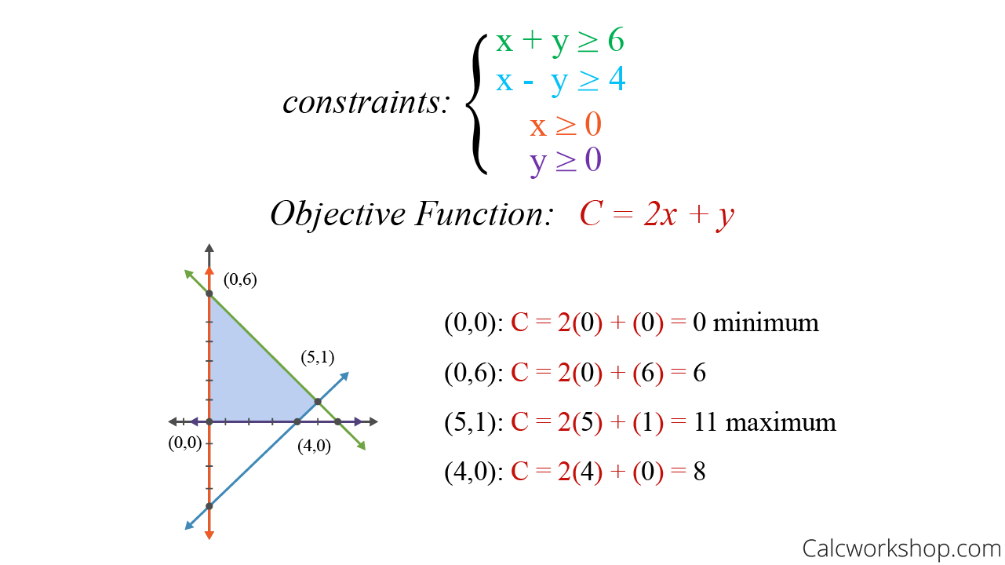
Linear Programming
The non negativity restrictions
Maximize or Minimize

Slide 9
Linear Programming
The context of a problem determines whether we want to know the objective function’s maximum or the minimum value.
For example, If a linear programming problem represents the amount of packaging material used by a company for their products, then a minimum amount of material would be desired. If a linear programming problem represents a company’s profits, then a maximum amount of profit is desired.

Slide 10
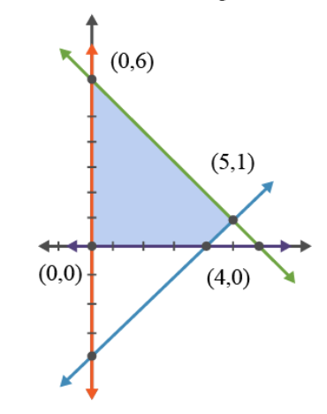
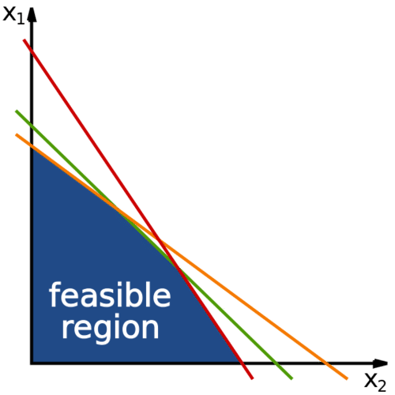
Linear Programming

Slide 11
Linear Programming
Two important rules:
Given that an optimal solution to a linear programming problem exists, it must occur at a vertex of the feasible set.
If the optimal solution occurs at two adjacent vertices of the feasible set, then the linear programming problem has infinitely many solutions. Any point on the line segment joining the two vertices is also a solution.

Slide 12
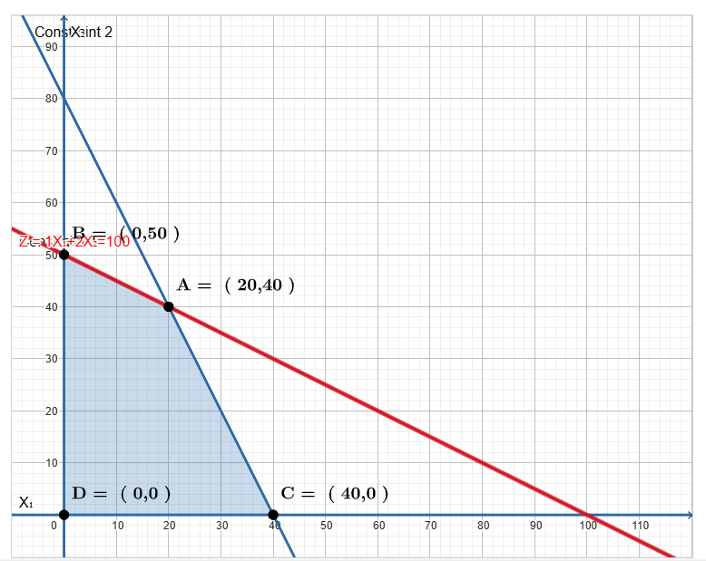
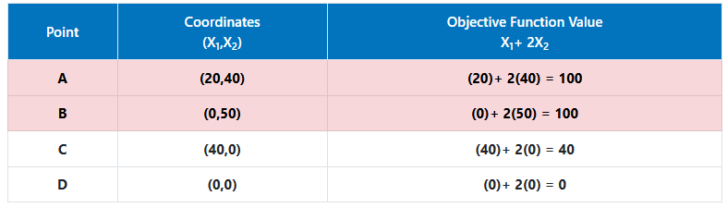

Infinite Solutions
Objective Function:
Z= x+2y
x | y | Value Objective Function
1 | 49.5 | 100
2 | 49 | 100
3 | 48.5 | 100

Slide 13
Linear Programming
An unbounded set is a set that has no bound and continues indefinitely. A linear programming problem with an unbounded set may or may not have an optimal solution, but if there is an optimal solution, it occurs at a corner point.
A bounded set is a set that has a boundary around the feasible set. A linear programming problem with a bounded set always has an optimal solution. This means that a bounded set has a maximum value as well as a minimum value.

Slide 14
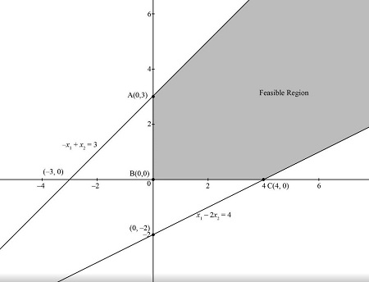
Linear Programming
Unbounded Set
Bounded Set

Slide 15
Linear Programming
Solving Linear Programming Problems – The Graphical Method
Graph the system of constraints. This will give the feasible set.
2. Find each vertex (corner point) of the feasible set.
3. Substitute each vertex into the objective function to determine which vertex optimizes the objective function.
4. State the solution to the problem.

Slide 16
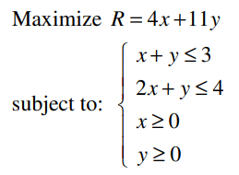
A Simple Example

Slide 17
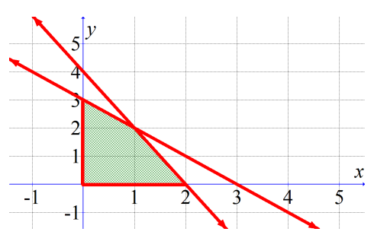
A Simple Example
Is a bounded region,
so there is a solution

Slide 18
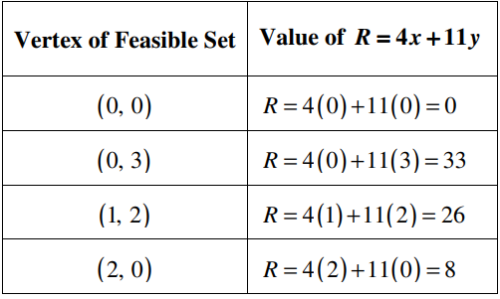
A Simple Example
The maximum is reached at (0,3)

Slide 19
A Modelling Example
A student wishes to optimize their daily time between studying and resting to maximize their academic performance. The student plans to dedicate a maximum of 8 hours a day to these activities. Studying for one hour improves their academic performance by 5 points, and resting for one hour improves their academic performance by 2 points. To keep the focus on studying the student has to dedicated at most 2 hours.

Slide 20
A Modelling Example
Objective Function:
Max Z=5x + 2y
Where
x: Number of hours dedicated to study for day.
y: Number of hours dedicated to rest for day.

Slide 21
A Modelling Example
Restrictions:
Time available in a day:
x+y<=8
Minimum hours needed of study to keep focus:
x<=2
Non Negativity:
x>=0, y>=0

Slide 22
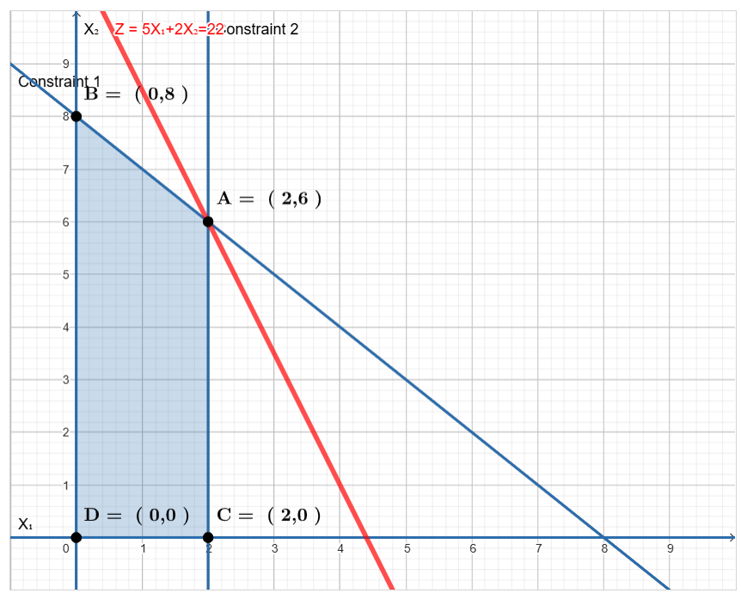
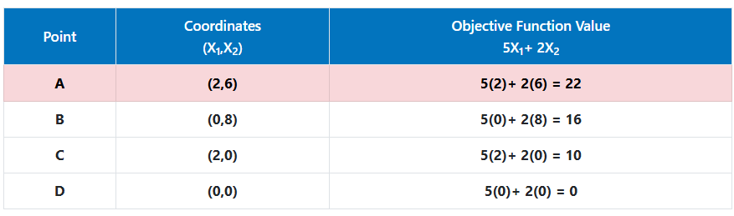
A Modelling Example

Slide 23
Using a graph tool
https://www.zweigmedia.com/utilities/lpg/index.html?lang=es
https://www.pmcalculators.com/graphical-method-calculator/

Slide 24
Restriction of the graphical method
It can only be used for 2 variables, for more than 2 variables we use Simplex Method.
This method implies to solve systems of linear equations. In the examples we are solving a problem with 2 variables and 2 restrictions but adding more restrictions is possible for linear programming problems and solving a system of linear equations not always give us a right answer in this case.
Also solving the system of linear equations not necesarially consider the non negativity restrictions.

Slide 25
Second Modelling Example
A clothing store sells t-shirts and trousers. Each t-shirt requires 1 hour of sewing work and 2 hours of tailoring work. Each pair of trousers requires 2 hours of sewing work and 1 hour of tailoring work. The store has 100 hours per week available for sewing and 80 hours per week available for tailoring. The profit from each t-shirt sold is $15, and the profit from each pair of trousers sold is $20.

Slide 26
Second Modelling Example
Objective Function:
Max Z=15x+20y
Where
x: Number of shirts manufactured by week
y: Number of pants manufactured by week

Slide 27
Second Modelling Example
Restrictions:
Hours available for sewing:
x+2y<=100
Hours available for tailoring:
2x+y<=80
Non Negativity:
x>=0, y>=0

Slide 28
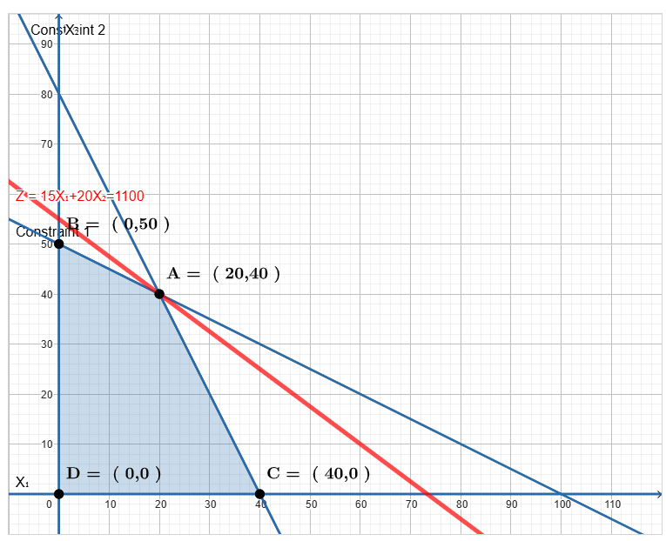
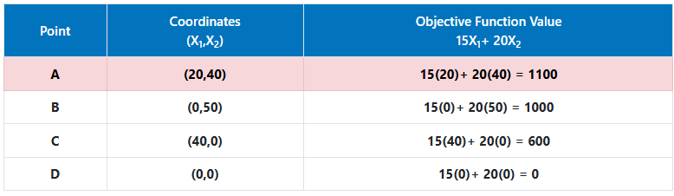
Second Modelling Example

